Slide 1
Truth

Slide 3
Slander

Slide 5
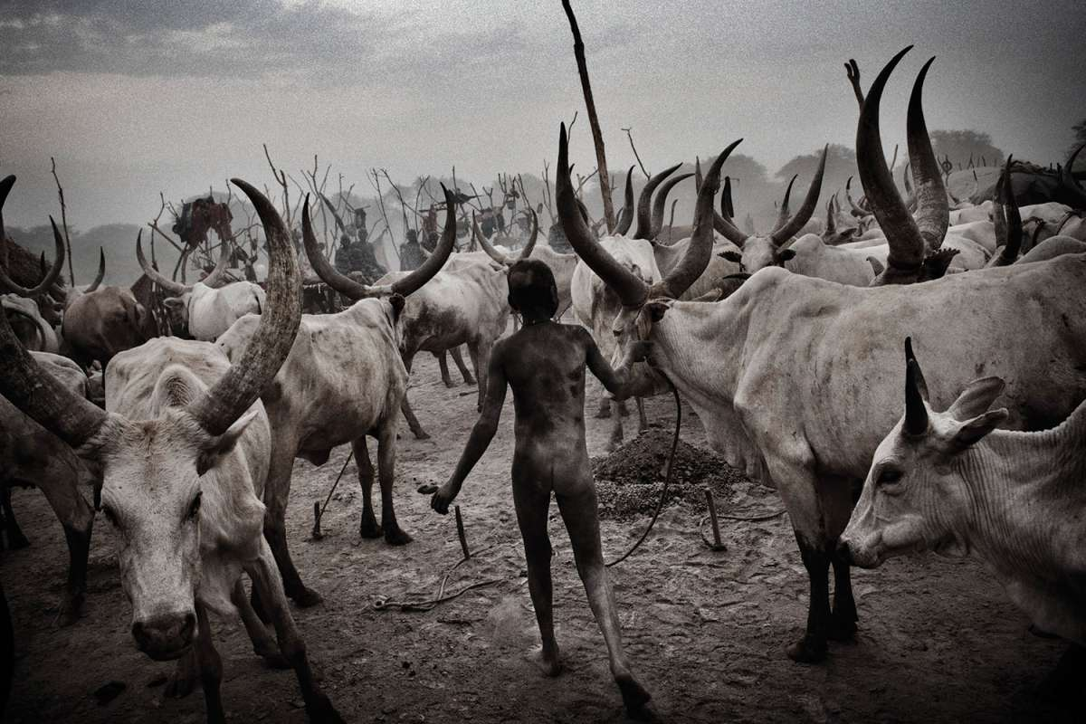
Slander

Slide 6
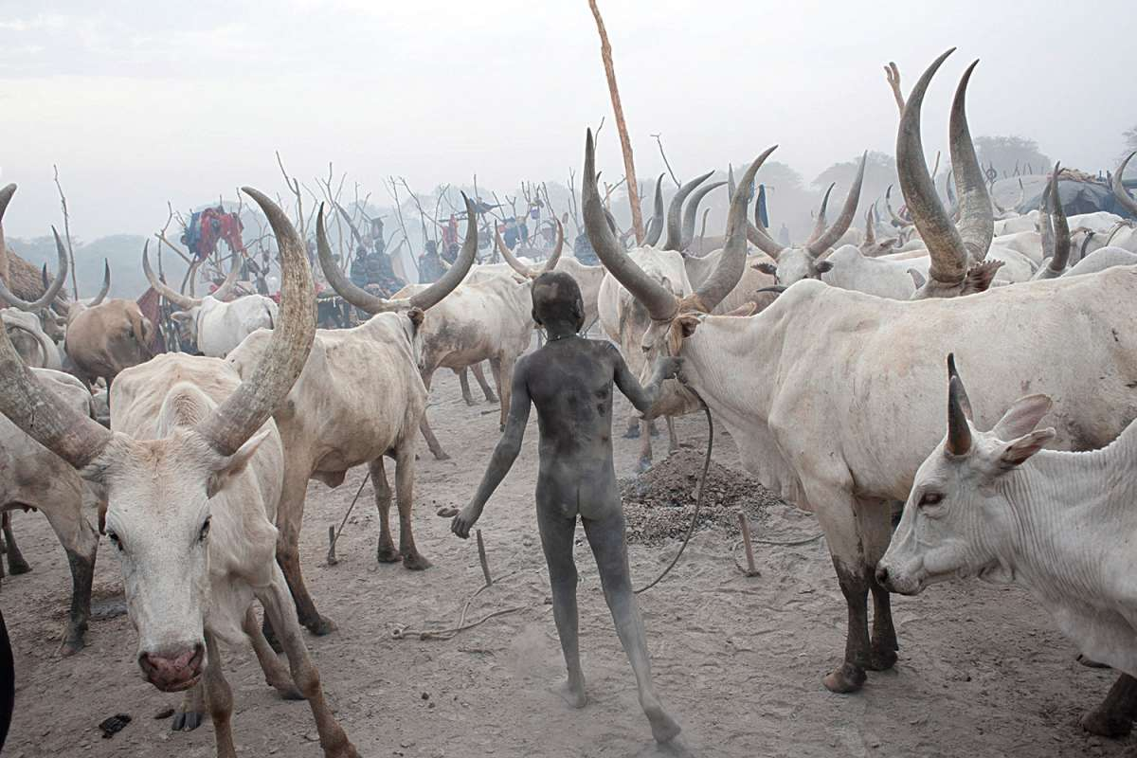

Slide 7
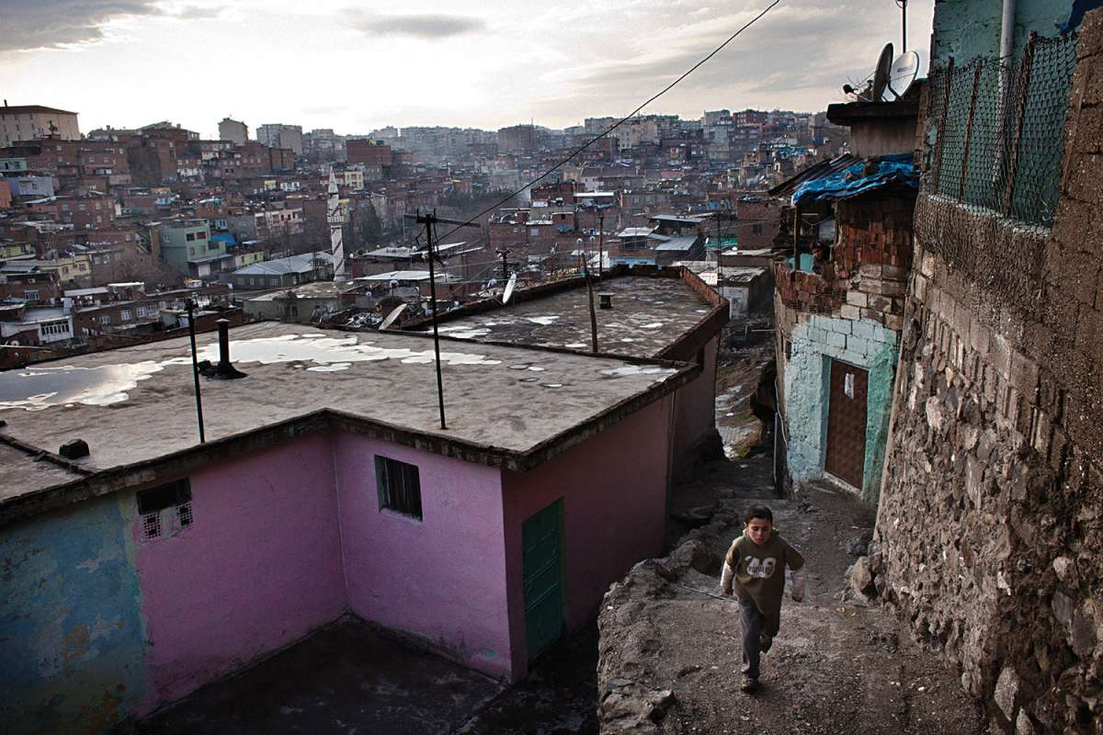
Slander

Slide 8
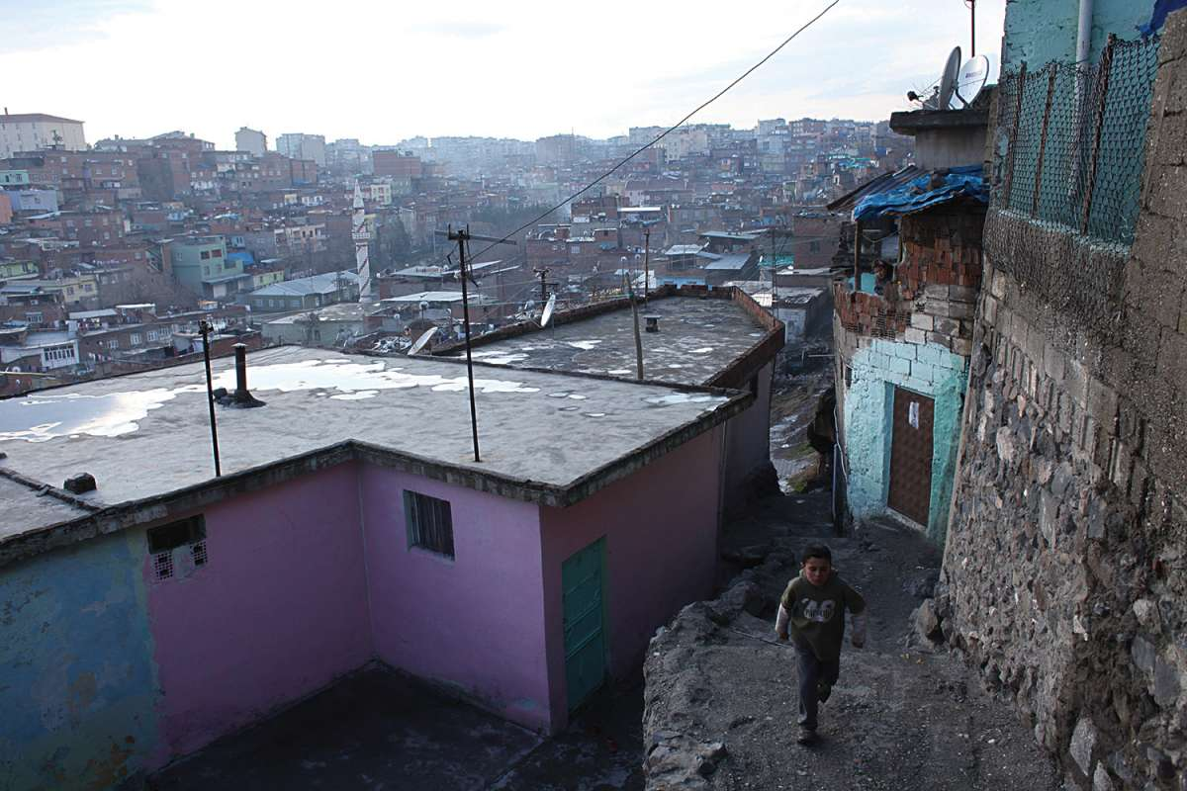

Slide 9
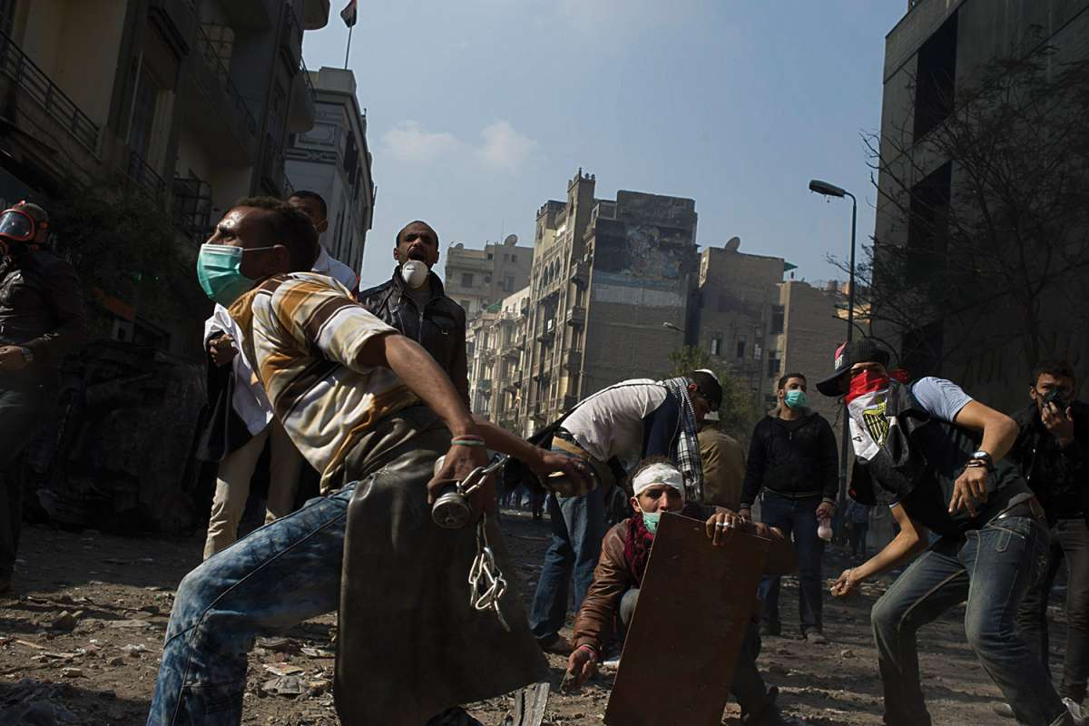
Truth

Slide 10
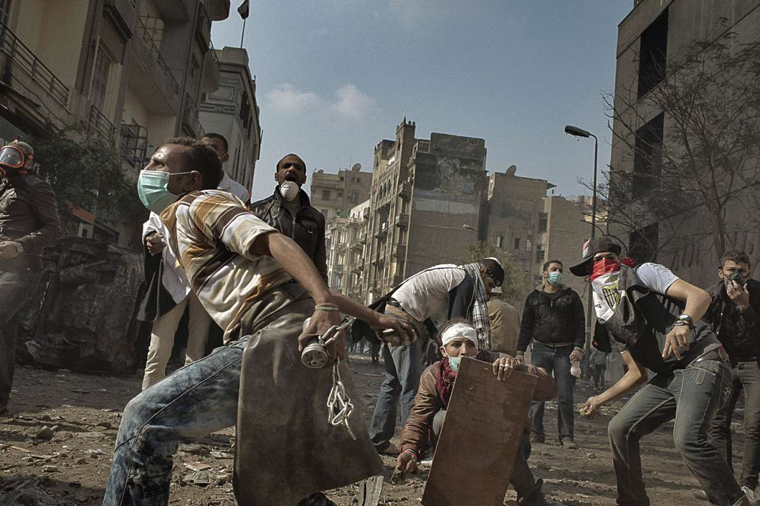

Slide 11
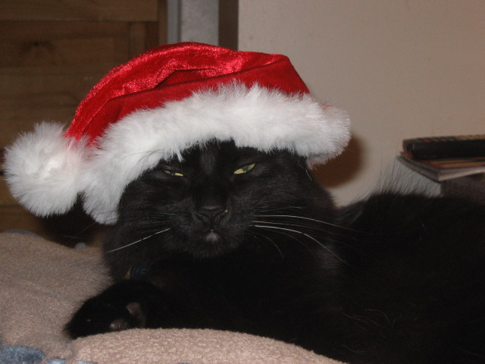
Truth

Slide 12
PollEverywhere
Text stephanievan344 to 780-800-5606

Slide 13
Agenda
Photo Manipulation Controversies
Photo Comparison Posters(Groups Yay!)
Gallery Walk

Slide 14
We are the messengers, we are the seekers of the truths, we must be the ones that show the light in the darkest corners of the world. When viewers can no longer trust the picture or the photographer taking it, we are nothing but tricksters
Stanley Greene

Slide 15
Retouching Reality New Articles
Questions
Is there a difference between digitally manipulated image in an advertisement and one in a news article? Does it depend on context?
Some people wondered if Microsoft changed the photo in order to appeal to a mostly white Polish audience. Would that be a valid reason to manipulate the photo? Do you think what they did was ethical?
To do:
Answer the first two questions
Debrief
Write answer to third question on sticky note

Slide 16
Poster Paper
Grab a group (maximum 4 people)
Pick a photo set
Examine what elements are different in each photo and how they alter your interpretations.

Slide 17
On your poster paper you must have:
What did they alter in the photograph?
How did they alter it? (Which parts did they darken? Which colors did they change?)
How might the alterations change your interpretation of the photograph? (pick at least three reasons)

Slide 18
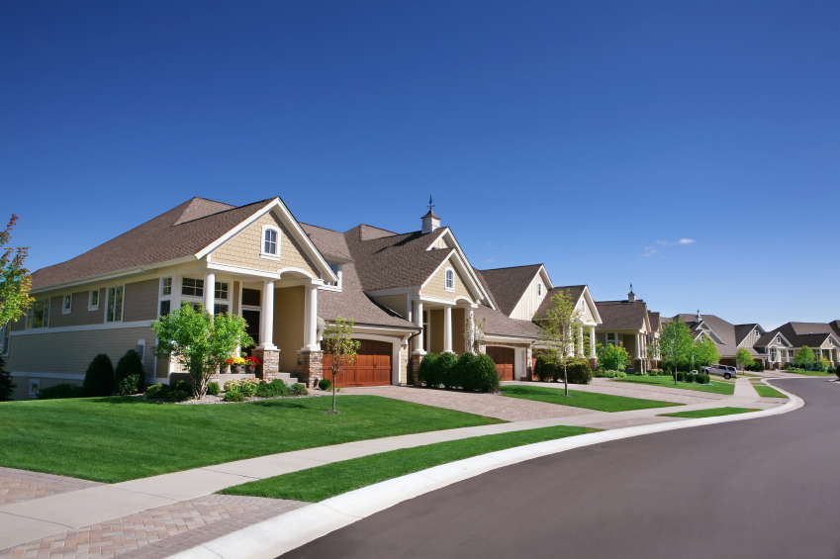
What adjectives would you use to describe this neighborhood?

Slide 19
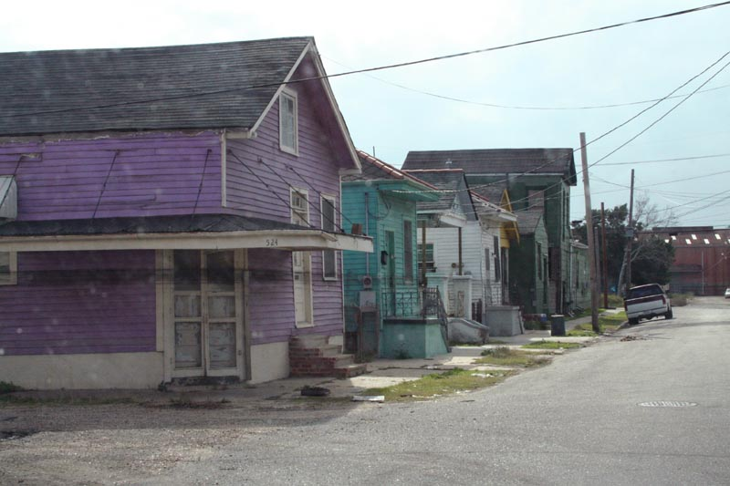
What adjectives would you use to describe this neighborhood?

